Slide 1

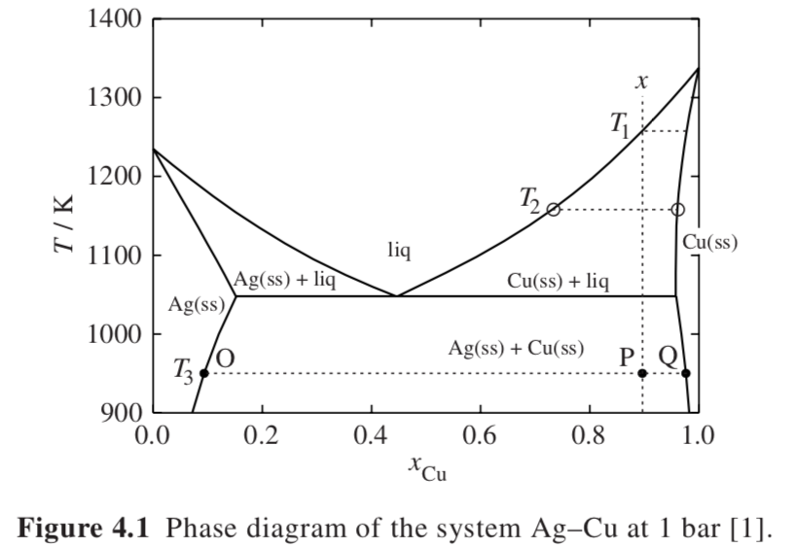




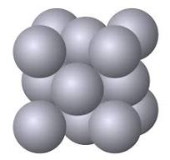
Gibbs Phase Rule
FCC a_{Ag} = 4.1 Å
FCC a_{Cu} = 3.6 Å
Phase Diagrams
2 is T and P; for isobaric
F +Ph = C + 1
Silver acts like a solvent to copper and copper acts like a solvent to silver with limited solubility that is a function of temperature with a solubility limit at the eutectic point (3 phases in equilibrium)
Eutectic Phase Diagram Ag + Cu
Univariant Equilibrium
Liquidus
Solidus
Invariant Equilibrium
Eutectic
Lever Rule
Tieline (conode)
and
L => α + Β

Slide 2
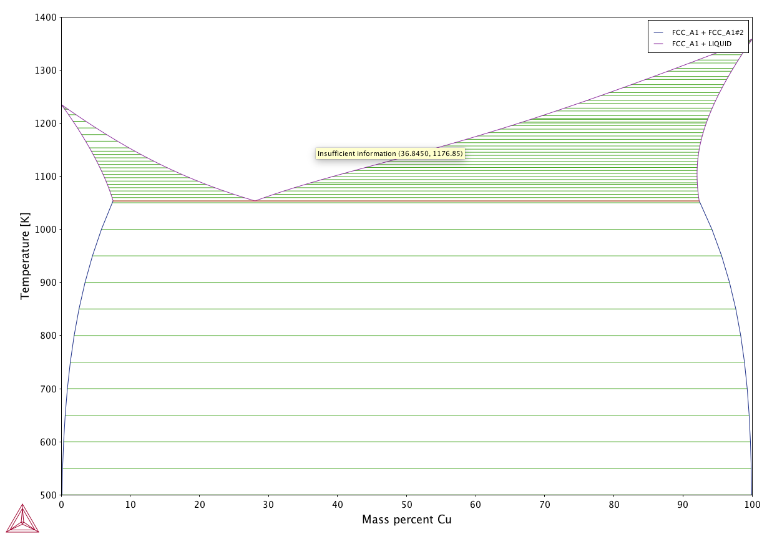
From Thermo-Calc Program (Solder Demo)
CALPHAD is another program for phase diagrams

Slide 3
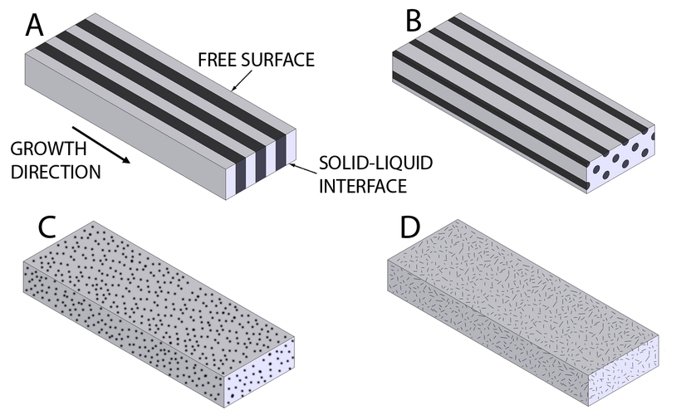
Gibbs Phase Rule
Phase Diagrams
Eutectic Phase Diagram Ag + Cu
Univariant Equilibrium
Liquidus
Solidus
Invariant Equilibrium
Eutectic
Lever Rule
Tieline (conode)
and
acicular = needle

Slide 4
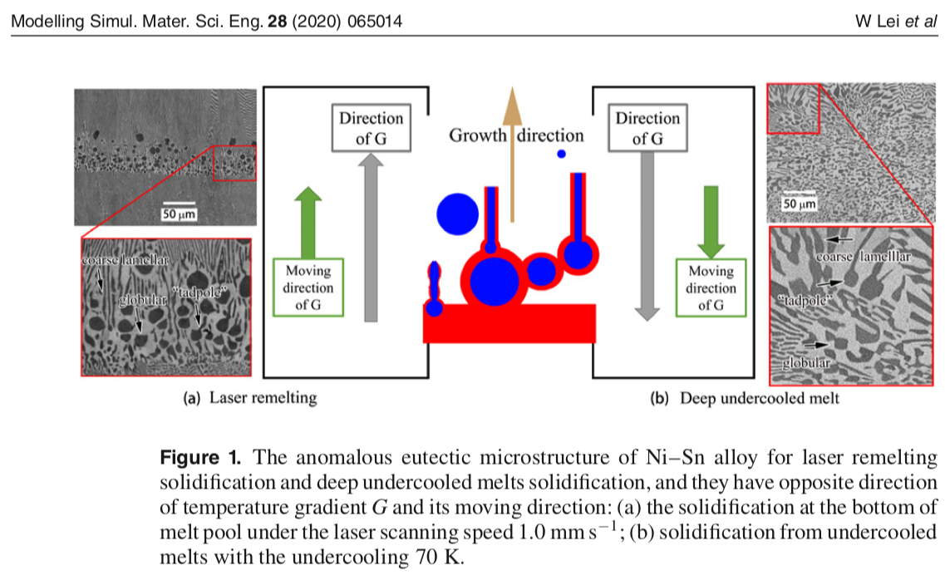
Phase Diagrams

Slide 5
Slow Cool Morphology
Consider the morphology in a slow cool from T1 (liquid) to T3 (solid). Just below T1 domains of Cu/Ag at about 98% Cu form in the liquid matrix. The fraction Cu/Ag solid increases as temperature drops, probably growing on the seeds formed at T1. By T2 the matrix is solid with domains of liquid. The composition of the matrix is richer in Ag at the outside, close to 95% Cu. At the eutectic domains of Cu/Ag with 15% Cu become immersed in a matrix of about 95% Cu/Ag. The entire system is solid so diffusion essentially stops and the structure is locked.
Rapid Quench Morphology
For a rapid quench to T3, domains of 10% Cu form in a matrix of 97% Cu.
Phase Diagrams

Slide 6
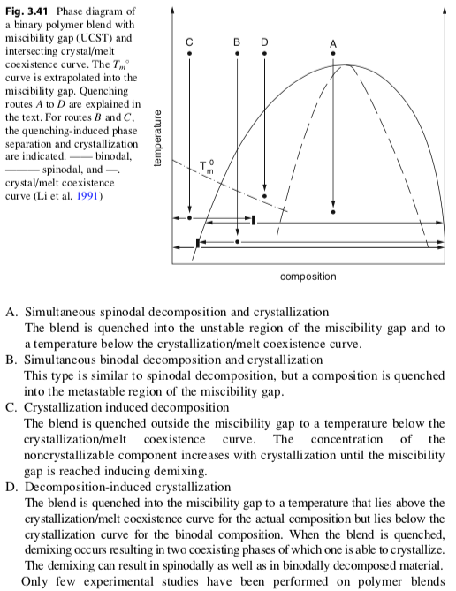
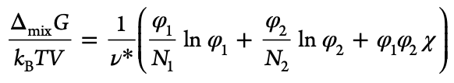
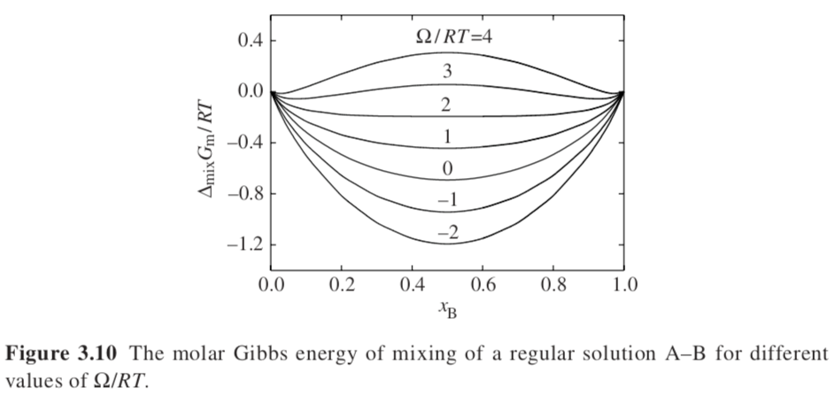
N₁ ≠ N₂
Y. Li, M. Stein, B.-J. Jungnickel, Colloid Polym. Sci. 269, 772 (1991); and ‘Mitteilungen aus dem
Deutschen Kunststoff-Institut’, Nr. 53, April, Darmstadt, 1991
N₁ = N₂

Slide 7
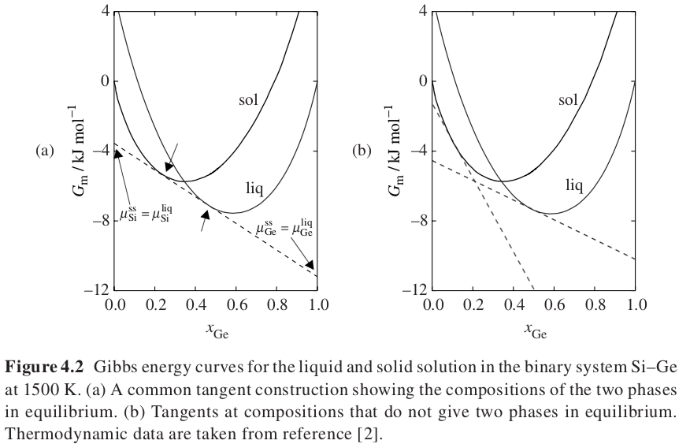
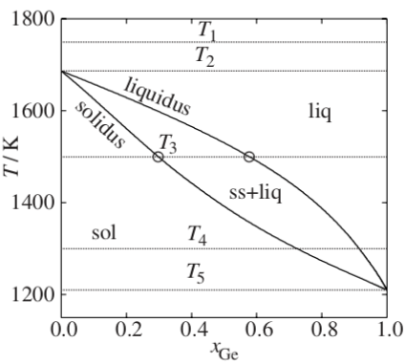
Solid Solutions
Does dG/dx_{i} = dG/dn_{i} = μ_{i}?
Not exactly
dG/dn_{i} = dG/dx_{i} dx_{i}/dn_{i}
dx_{i}/dn_{i} = d(n_{i}/(n_{i}+n_{j}))/dn_{i} = 1/(n_{i}+n_{j}) – n_{i}/(n_{i}+n_{j})²
Common Tangent Construction
T₃
Both have diamond cubic structure

Slide 8
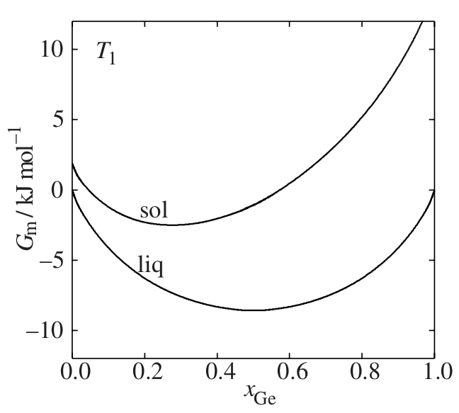
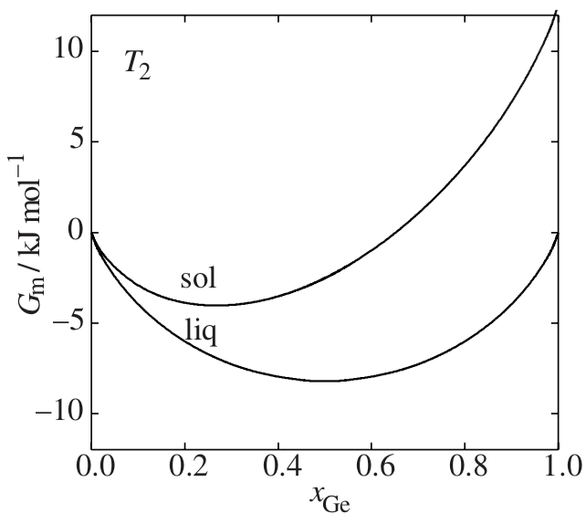
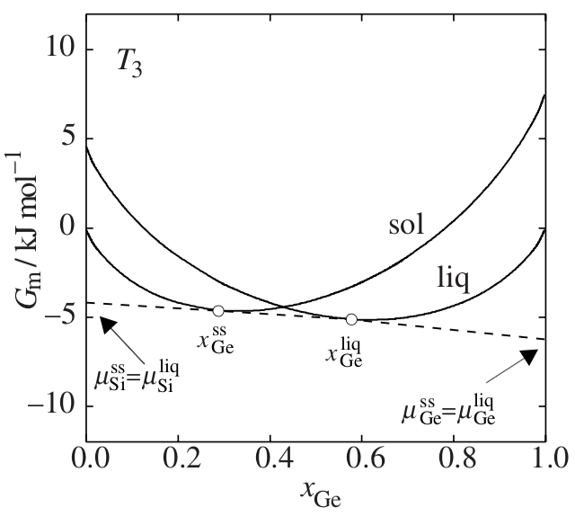
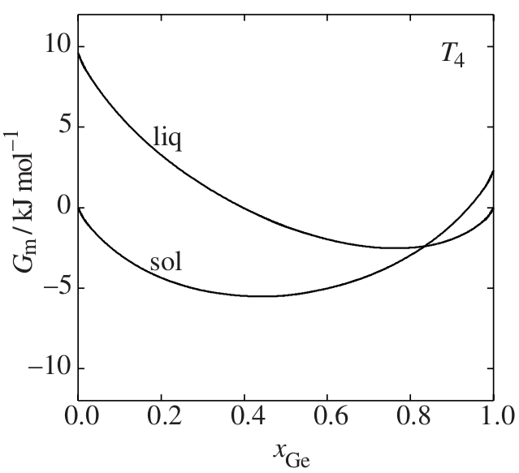
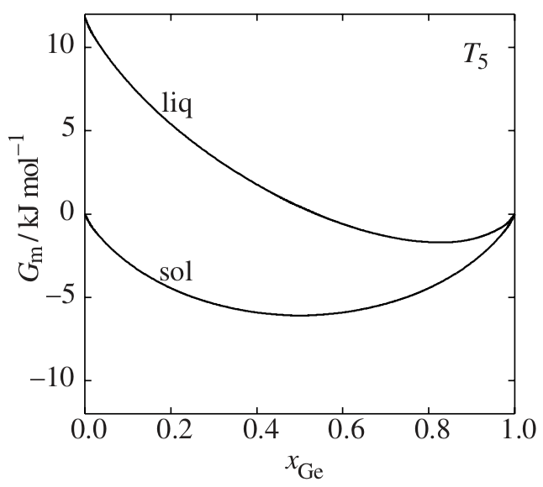
Si-Ge phase diagram
Si-Ge Gibbs Free Energy
Single crossing of solid/liquid free energy curves

Slide 9

Pressure Expression: Mix two ideal gasses, A and B
-S U V
H A
-p G T
p = p_{A} + p_{B}
p_{A} is the partial pressure p_{A} = x_{A}p
For single component molar G = μ
μ₀ is at p_{0,A} = 1 bar
At pressure p_{A} for a pure component isothermal ideal gas
μ_{Α} = μ_{0,A} + RT ln(p/p_{0,A}) = μ_{0,A} + RT ln(p)
For a mixture of A and B with a total pressure p_{tot} = p_{0,A} = 1 bar and p_{A} = x_{A} p_{tot}
For component A in an ideal binary mixture
μ_{Α}(x_{A}) = μ_{0.A} + RT ln (x_{A} p_{tot}/p_{0,A}) = μ_{0.A} + RT ln (x_{A})
dG=SdT+Vdp
Isothermal and Ideal Gas
dG = RTdp/p
Isothermal and Real Gas
μ_{A}* = μ_{0.A} if p = 1

Slide 10
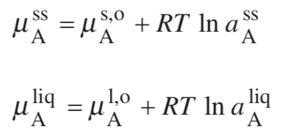
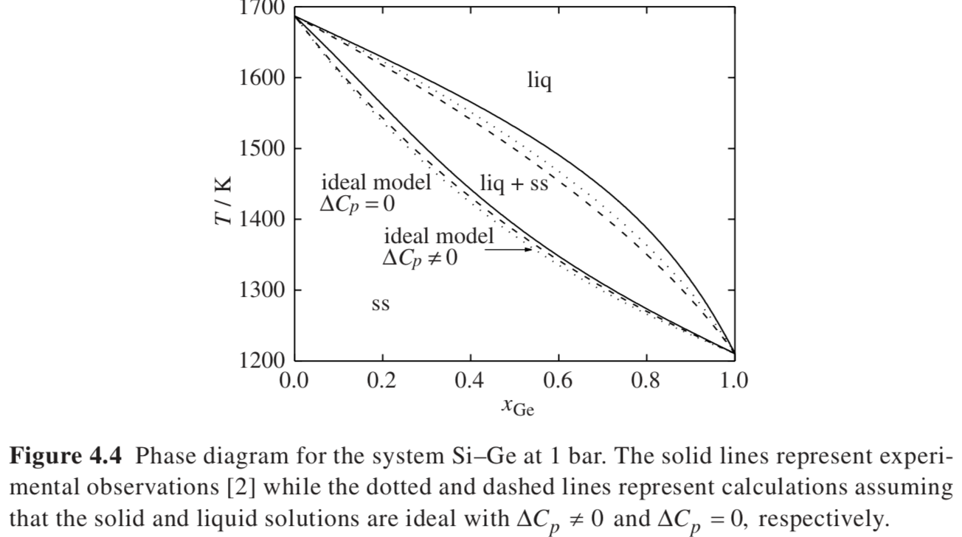
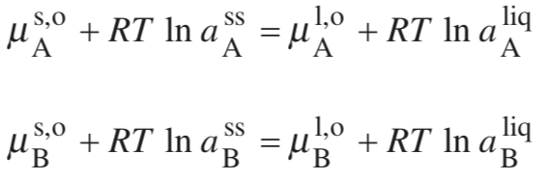


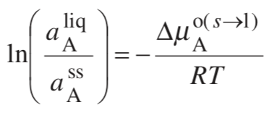
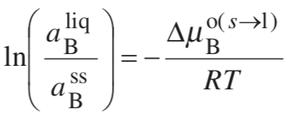



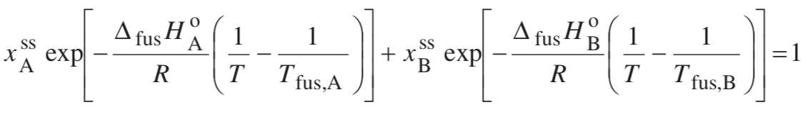
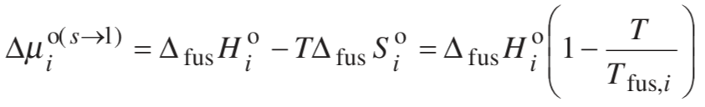
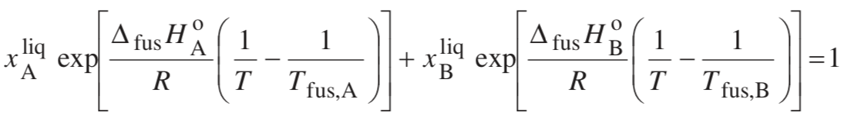
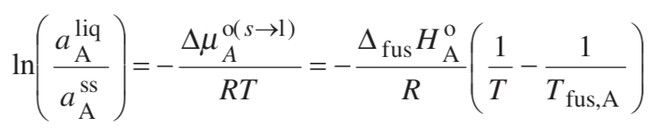
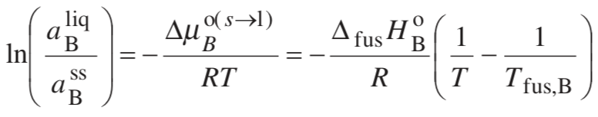
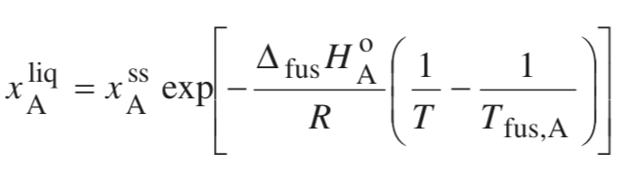
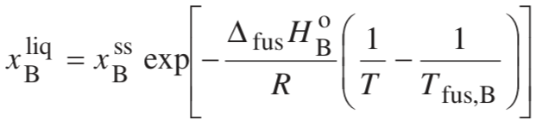
Calculate the Phase Diagram for a Solid Solution
Solve for x_{B}^{SS} x_{B}^{liq} since x_{A} + x_{B} =1
C_{p}(T) is constant
For Ideal you can solve the phase diagram knowing the melting points and heats of fusion.
Ideal
x_{A} + x_{B} =1

Slide 11
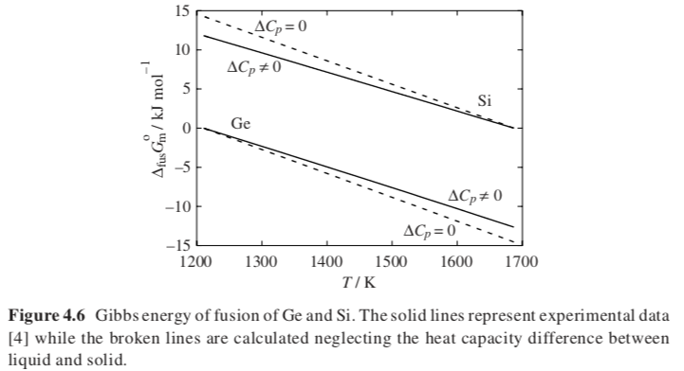
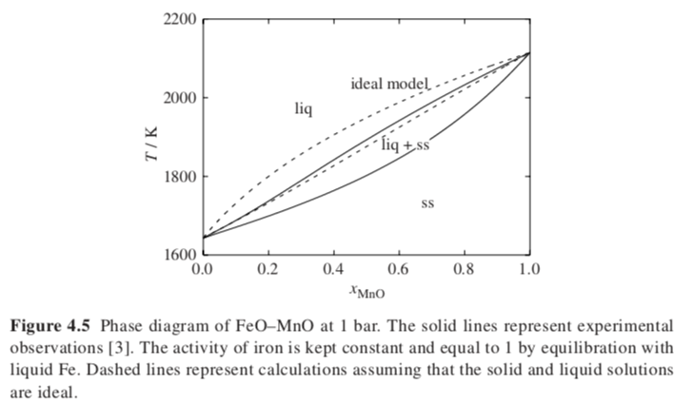

Slide 12
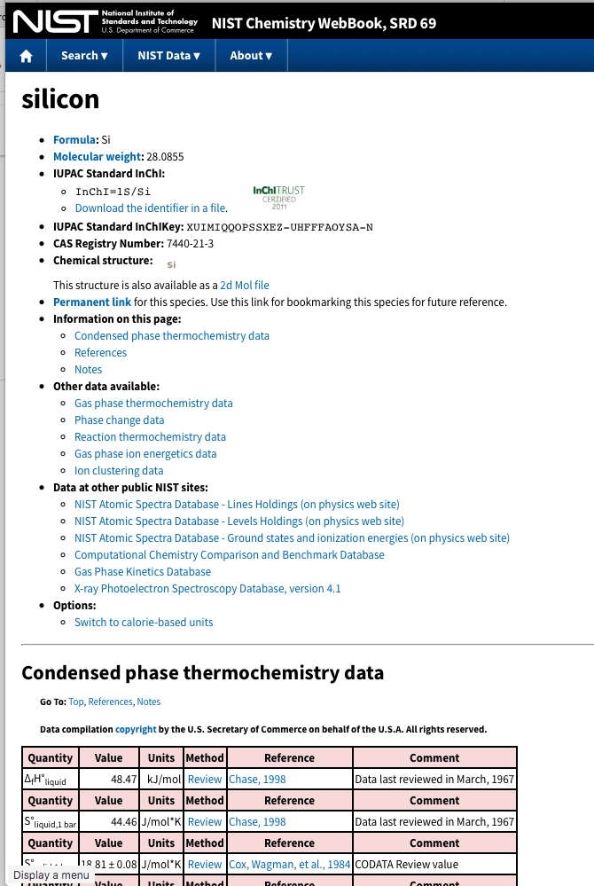


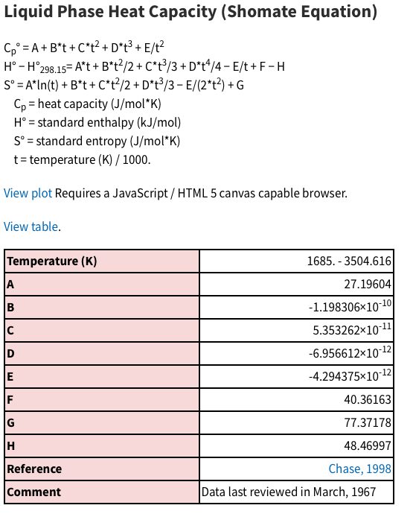
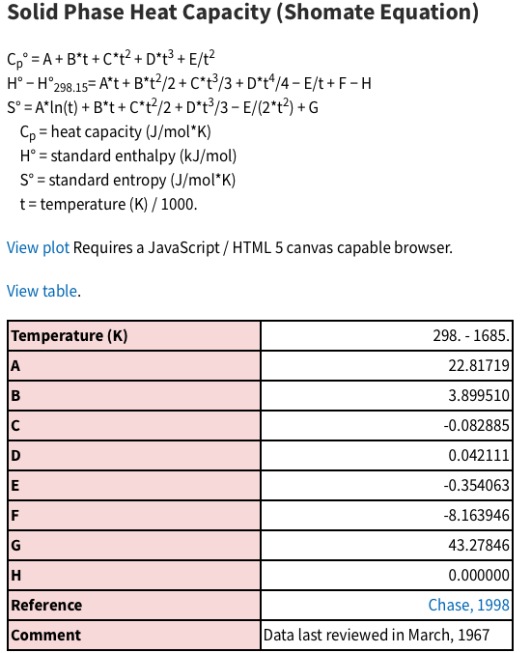
https://webbook.nist.gov/chemistry/name-ser/

Slide 13
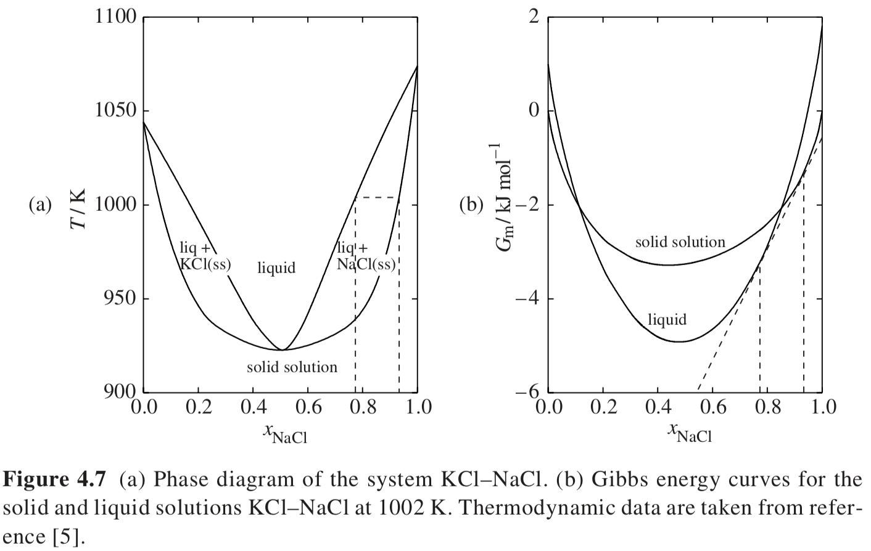
Congruent Melting
~1005 K
Double crossing of solid/liquid free energy curves
Solid solution is flatter than ideal (Pos. deviation or destabilized) Liquid is deeper than ideal (Neg. Deviation or stabilized)
Deviations are associated with minima in phase diagram

Slide 14
Phase diagram is split into two solid solutions by the congruent melting point
Solid solution is flatter than ideal (Pos. deviation or destabilized) Liquid is deeper than ideal (Neg. Deviation or stabilized)
Deviations are associated with minima in phase diagram

Slide 15
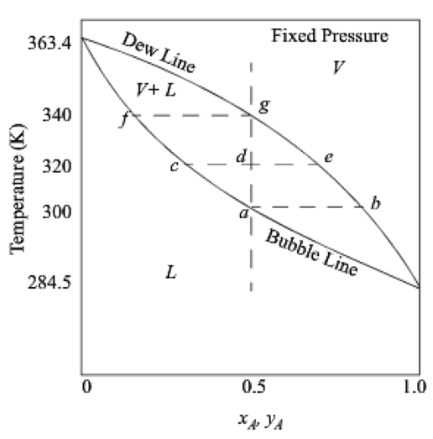
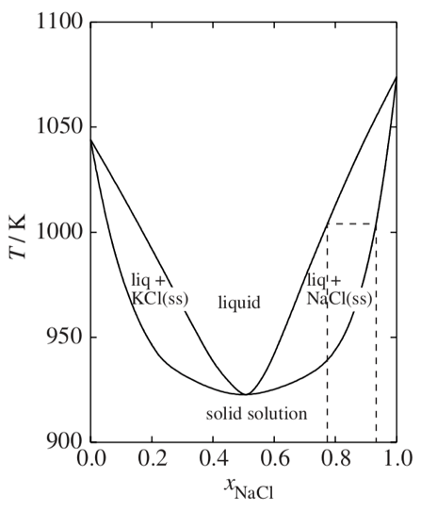
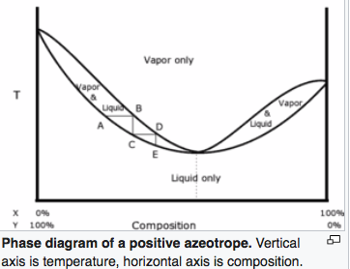
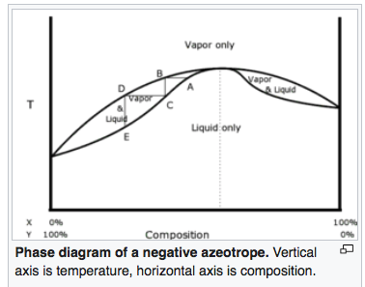
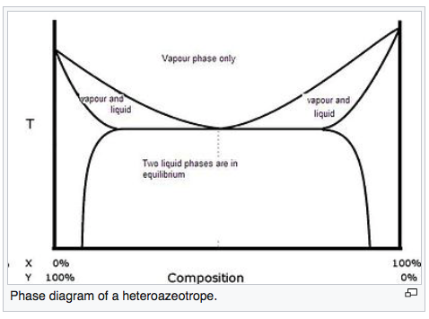
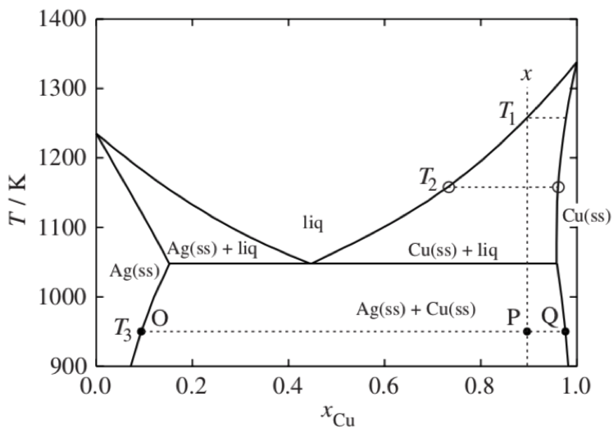
Liquid/Vapor Equilibria
Liquid/Liquid
Equilibria
Solid/Liquid Equilibria
Ideal
Ideal
L => α + L
Azeotrope
Phase diagram is split into two phase diagrams with a special composition that acts as a pure component
Non-Ideal
Congruent melting solid solution
L => α
Same crystallographic structure in solid solution phase
Heteroazeotrope
Eutectic
L => α + β
Different crystallographic structures in solid solution phases

Slide 16
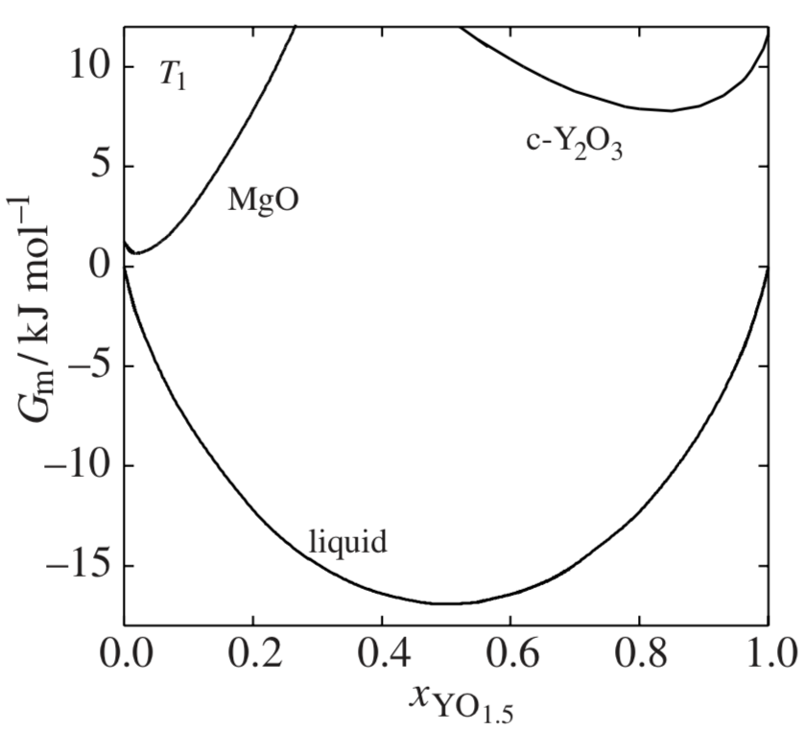
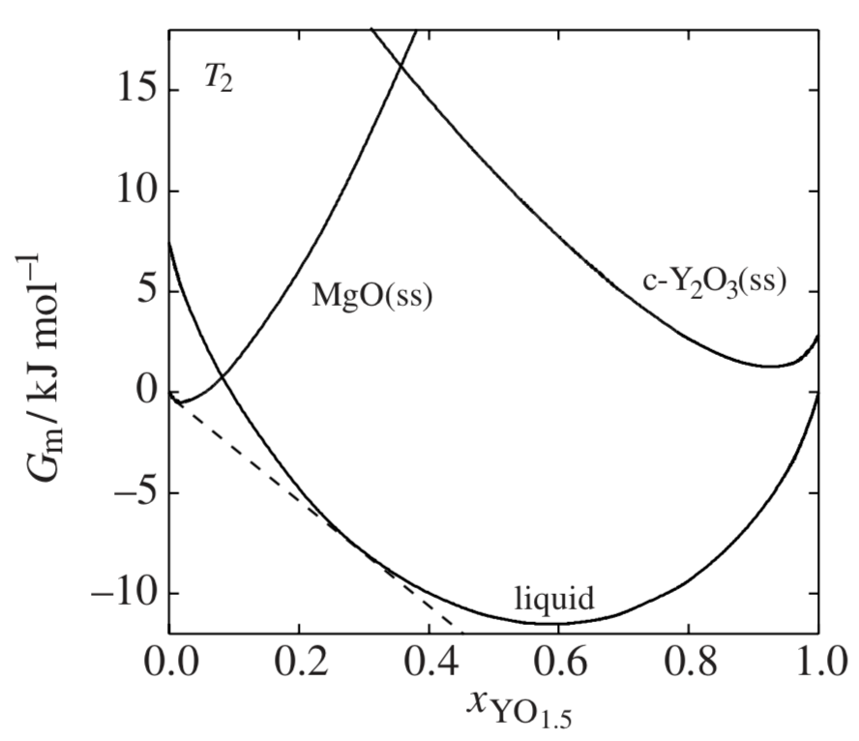
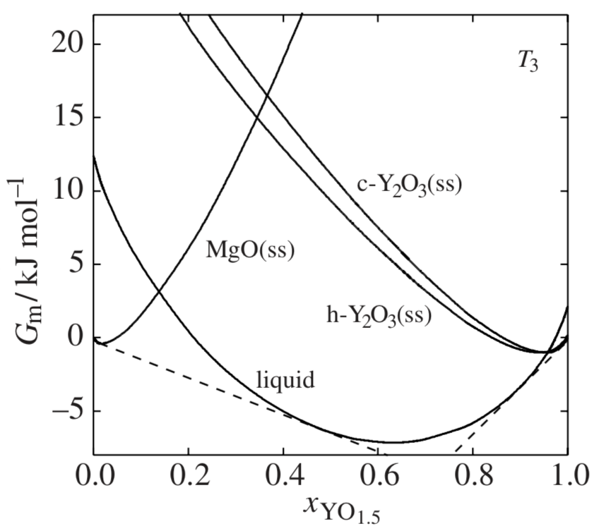
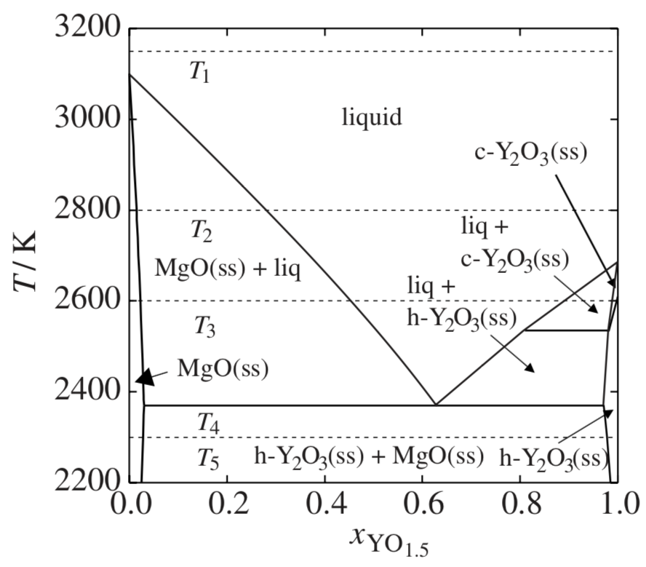
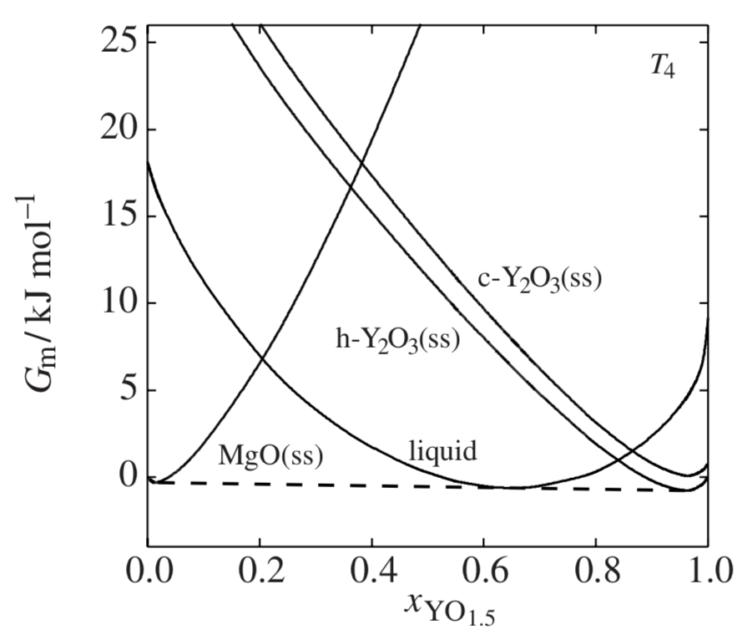
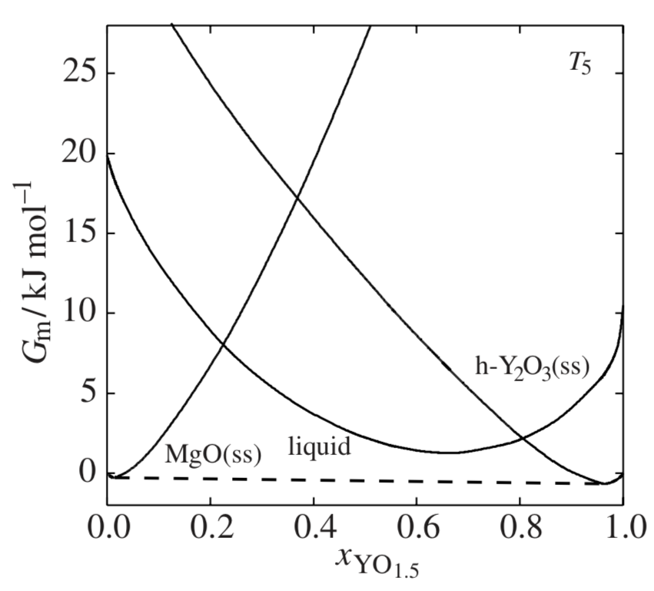
Eutectic Phase Diagram with Three Crystallographic Phases, Two Cubic and One Hexagonal

Slide 17
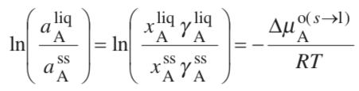
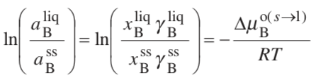


Regular Solution Modeling for Phase Diagrams
G^{E}/RT = x_{A} ln γ_{A} + x_{B} ln γ_{B} Generic expression using activity coefficient
G^{E}/RT = Ω x_{A} x_{B} Hildebrand Regular Solution expression
Two unknowns & Two equations:
We found that a solution of RT ln γ_{A} = Ω x_{B}² and RT ln γ_{B} = Ω x_{A}² worked
Knowing 2 omegas and the temperatures and heats of fusion you can predict the phase diagram
Two unknowns, x_{B}^{SS}, x_{B}^{liq} & Two equations
Solve numerically
Generate Phase diagram since Δµ is a function of T
Positive Ω is necessary for phase separation
ΔG_{m} = RT(x_{A} ln(x_{A}) + x_{B} ln(x_{B})) + Ω x_{A}x_{B}

Slide 18
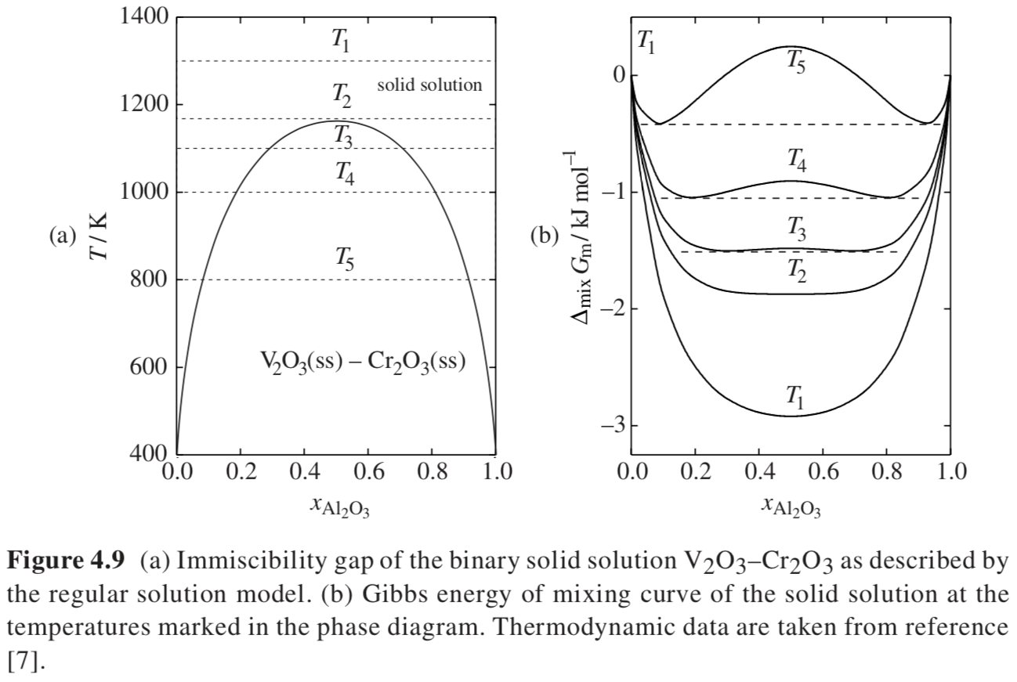
One Crystallographic
Phase
γ => α + β
Two Different Crystallographic
Phases at Equilibrium

Slide 19
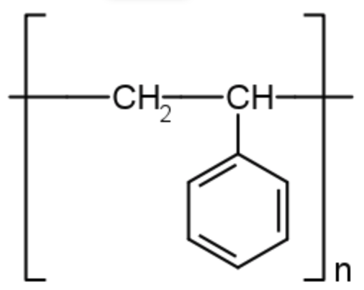
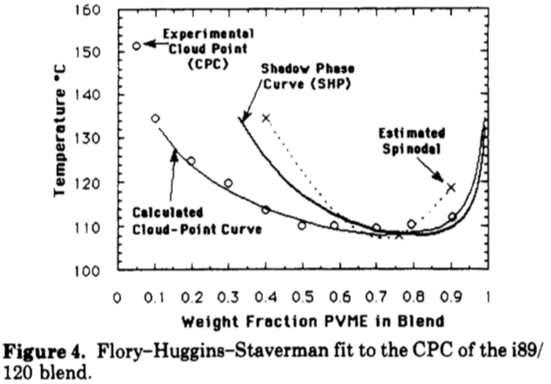




Polyvinylmethyl Ether/Polystyrene (LCST Phase behavior)
2-Phase
2-Phase
Single Phase
Single Phase
ΔG_{m} = RT(x_{A} ln(x_{A}) + x_{B} ln(x_{B})) + Ω x_{A}x_{B}
must have a temperature dependence for UCST
Ω = A + B/T so that it gets smaller with increasing temperature this is a non-combinatorial entropy i.e. ordering on mixing

Slide 20

Pure A and B melt at 800 and 1000 K with the entropy of fusion of both compounds set to 10 J K^{–1} mol^{–1} typical for metals. The interaction coefficients of the two solutions have been varied systematically in order to generate nine different phase diagrams.
Congruent melting
Congruent melting
Solid & liquid Ideal
Ω^{liq} = -15 kJ
Ω^{ss} = 0
Ω^{liq} = 0
Ω^{ss} = 0
Ω^{liq} = +15 kJ
Ω^{ss} = 0

Slide 21
Pure A and B melt at 800 and 1000 K with the entropy of fusion of both compounds set to 10 J K^{–1} mol^{–1} typical for metals. The interaction coefficients of the two solutions have been varied systematically in order to generate nine different phase diagrams.
Solid & liquid Ideal
congruently melting solid solution
Ω^{liq} = -15 kJ
Ω^{ss} = 0
Liquid stabilized
Ω^{liq} = 0
Ω^{ss} = 0
Ω^{liq} = +15 kJ
Ω^{ss} = 0
Liquid destablized
congruently melting solid solution

Slide 22

Pure A and B melt at 800 and 1000 K with the entropy of fusion of both compounds set to 10 J K^{–1} mol^{–1} typical for metals. The interaction coefficients of the two solutions have been varied systematically in order to generate nine different phase diagrams.
Eutectic
Eutectic
Ω^{liq} = 0 kJ
Ω^{ss} = 15 kJ
Ω^{liq} = +15 kJ
Ω^{ss} = +15 kJ
Solid & Liquid
destablized
Ω^{liq} = -15
Ω^{ss} = 15 kJ
Solid destabilized
& liquid stabilized
Solid destabilized

Slide 23

Pure A and B melt at 800 and 1000 K with the entropy of fusion of both compounds set to 10 J K^{–1} mol^{–1} typical for metals. The interaction coefficients of the two solutions have been varied systematically in order to generate nine different phase diagrams.
Congruent melting
Ω^{liq} = -10 kJ
Ω^{ss} = -10 kJ
Solid & Liquid
stablized
Ω^{liq} = 0
Ω^{ss} = -10 kJ
Solid stabilized
Ω^{liq} = +10 kJ
Ω^{ss} = -10 kJ
Solid stabilized
liquid destabilized

Slide 24



If it is assumed that
Then you need only one Ω
(The solid state doesn’t mix)
Regular solution model has only a few parameters
This means that experimentally you need only determine a few points of equilibrium composition to predict the entire phase diagram.

Slide 25


Invariant Phase Equilibria
F = C – P + 2 for binary F = 4 – P composition diagram holds one DOF constant
There are three degrees of freedom for a binary system. If three phases meet the conditions are invariant. This means that the phase composition acts like a pure component. An azeotrope or congruent melting point splits the phase diagram into two phase diagrams. There are several types of “invariant reactions”.
Azeotrope V => L Composition fixed, x_{i} = y_{i}
Congruent melting point L => S Composition fixed, x_{i}^{s} = x_{i}^{l}
Hex to Cubic Phase transition of Y₂O₃ Comp. fixed
Peritectic Reaction
Peritectoid = 3 solid phases
Eutectic Reaction
Eutectoid = liquid & 2 solid phases
Monotectic Reaction L₁ => S + L₂
Syntectic Reaction L₁ + L₂ => S

Slide 26

Stoichiometric Intermediate Phase, CaZrO₃
Stoichiometric Intermediate Phase
Only stable at one exact composition where it has a very low free energy

Slide 27

Intermediate Phases
The intermediate phases in the system Si–Ti display also a variety of other features. While TiSi2 and Ti5Si3 are congruently melting phases (melt and crystal have same composition), Ti5Si4 and TiSi melt incongruently. Finally, Ti3Si decomposes to β-Ti and Ti5Si3 at T = 1170 K, in a peritectoid reaction (3 solid phases) while β-Ti decomposes eutectoidally (L and 2S) on cooling forming α-Ti + Ti3Si at T = 862 K.

Slide 28

Antimony

Slide 29



Monotectic Phase Diagram
L₁ => L₂ + α
Nano-structure Bi
Self-lubricating bearings

Slide 30

Freezing Point Depression
Pure solid in equilibrium with a binary solution following Henry’s Law
dµ_{B,Solid} = V^{m}_{B,Solid} dP – S^{m}_{B,Solid} dT + RT d(lna_{B,Solid})
-S U V
H A
-p G T
Isobaric, pure component B so lna_{B,Solid} = 0
dµ_{B,Solid} = – S^{m}_{B,Solid} dT_{fp}
dG = Vdp – SdT
Binary solution following Henry’s Law
dG=-SdT+Vdp
Isothermal and Ideal Gas
dG = RTdp/p
G = RT ln(p/p₀) = RT ln(a)
dG = RT d(ln(a))
For solution
dG = RT d(ln(x/x₀)) = RT d(ln(x))
dµ_{B,Solution} = – S^{m}_{B,Solultion} dT_{fp} + RT_{fp} d(lny_{B,Solution})_{P,T}
For small x: e^{-x} = 1 - x + … or ln(1-x) = -x
So, for small y_{B,Solution}: lny_{B,Solution} ~ -y_{A,Solution}
So, if dµ_{B,Solid} = dµ_{B,Solution}
S^{m}_{B,Solid} dT_{fp} = S^{m}_{B,Solution} dT_{fp} + RT_{fp} dy_{A,Solution}
dy_{A,Solution} = (S^{m}_{B,Solid} - S^{m}_{B,Solution})/(RT_{fp}) dT_{fp} ~ -ΔS^{m}_{B}/(RT_{fp}) dT_{fp} = -ΔH^{m}_{B}/(RT_{F}) (dT_{fp})/T_{fp}
y_{A,Solution} = -ΔH^{m}_{B}/(RT_{F}) ln(T_{fp}/T_{F}) For small x: ln(x) = x – 1
y_{A,Solution} = -ΔH^{m}_{B}/(RT_{F}) (T_{fp}/T_{F} - 1) = -ΔH^{m}_{B}/(RT²_{F}) ΔT
T_{fp} = T_{F} - y_{A,Solution}RT²_{F}/ΔH^{m}_{B}

Slide 31


ΔT = -RT²_{F}y_{A,Solution}/ ΔH^{m}_{B}

Slide 32


Ternary Phase Diagram, x_{A}, x_{B}, x_{C}
With no grid you can get the composition
From the normals
Go clockwise
0 at start 1 at corner
Phase point is where parallel lines meet
Plot is isothermal, isobaric, isochoric
x_{A} + x_{B} + x_{C} = 1
This can be read if the plot has a grid
You can also use intersection lines to get the composition

Slide 33



Slide 34



Predominance Diagram (Which species is dominant)
pH = -log [H⁺]
pCr = -log [Cr]

Slide 36

Chapter 18 Electrolytes
Strong Electrolyte NaCl in water (strong dielectric, ions completely formed)
Weak Electrolyte Acetic Acid in water (use dissociation constant)

Slide 37


Chapter 18 Electrolytes
Handbook of Aqueous Electrolyte Thermodynamics

Slide 38


Colligative (counting) Properties
Melting Point Depression
Osmotic Pressure Π/RT = (c/M_{w}) (1 + B₂ c + …)
y_{H2O} P = P = x_{H2O}P_{H20}^{Sat}
Boiling Point Elevation (for non-volatile solute)

Slide 39



Slide 40


Slide 41


Slide 42



Speciation and dissociation constant K_{a,298}, charge balance
a_{H+} is dimensionless, [H⁺] is moles/liter (molarity, M_{H+})
A neutral solution is pure water so a_{H2O} = 1
With temperature changes [H⁺] changes due to thermal expansion
Molality, number of moles of H⁺ per kg of H₂O is used, m_{H+}

Slide 43


Slide 44
Concentration with speciation
Acetic Acid in water
Apparent concentration: g/liter you put in of C₂H₄O₂
True concentration has to do with the dissociation species (based on a model)
VLE is based on the true concentration of undissociated species

Slide 45


pH
pH = -log₁₀(a_{H+})
a_{H+} is molal (molar as an approximation)

Slide 46




Electrolyte Equilibrium Constant
Succinic Acid

Slide 47


Water of hydration and hydronium ion
Cations have water of hydration associated with the ion
Degree of hydration changes with concentration
At high concentrations ion pairs with the counter ion form

Slide 48

Acids and conjugate bases

Slide 49


Strong Acid
[H⁺] is large so [OH⁻] is very small, can be ignored
pH ~ pC_{A}

Slide 50



Strong Base
[OH⁻] is large so [H⁺] is very small, can be ignored
pOH ~ pC_{B}

Slide 51




Weak monoprotic Acid (Acetic Acid pK_{a,A} = 4.7)

Slide 52



Weak monoprotic Based (Acetate ion pK_{a,B} = 9.3)
Start with sodium acetate which is a strong electrolyte, the resulting acetate ion is a weak base
Convert to an acid equation and work with weak acid

Slide 53

Acid or Base Added to water

Slide 54

Base
Acid
Standard acid form of eqn. 18.38
At 298K, K_{a,B} = 6.18 e-13 from eqn. 18.39
K_{a,A} = 1e-14/6.18e-13 = 0.0162 or pK_{a,A} = 1.79
Fluconazole is protonated below pH = 1.8 and neutral (undissociated) above
pH = 7
None is dissociated so:

Slide 55
Base
Acid
Standard acid form of eqn. 18.39
At 298K, K_{a,B} = 6.18 e-13 from eqn. 18.39
K_{a,A} = 1e-14/6.18 e-13 = 0.0162 or pK_{a,A} = 1.79
Fluconazole is protonated below pH = 1.8 and neutral (undissociated) above
pH = 1.5
About half is dissociated:

Slide 56

Sillén Diagram or Bjerrum Plot or Hägg Diagram
4.76 = pKa

Slide 57





Sillén Diagram

Slide 58


Slide 59


Slide 60



[OH⁻][H⁺]=10⁻¹⁴ so log [OH⁻]+log[H⁺] = 14 (two lines as drawn)
When one component is small the other is C_{B}
When [OAc⁻] = [HOAc] then K_{a,A} = [H⁺]
Strong Base/Weak Acid, Answer is Basic
In Basic region
[H⁺] << [HOAc]
So [HOAc] ~ [OH⁻] for solution at pH 8.4
[HOAc] is parallel to [H⁺] when [H⁺] is small
[H⁺]=10⁻¹⁴/[OH⁻] so [OAc⁻] is parallel to [OH⁻] when [OH⁻] is small

Slide 61



Slide 62


Slide 63



Slide 64





Slide 66


Slide 67





Slide 68


Slide 69

Amino Acids (Zwiterions)

Slide 70

Amino Acids (Zwiterions)

Slide 71



Slide 72
Charge balance (18.67) is reached about where 1.1[H₂Gly⁺] = [Gly⁻], a little above pH = 6

Slide 73



Buffer: a salt and an acid that share a common ion
Acetic Acid and Sodium Acetate
Henderson-Hasselbalch Equation

Slide 74
Buffer: a salt and an acid that share a common ion
Acetic Acid and Sodium Acetate
Better equation:

Slide 75

Isoelectric Point
For a zwitterion like an amino acid amines protonate at neutral pH and carboxylic acids are deprotonated. When there is no net charge the pH = pI is the isoelectric point. Solubility is at a minimum at the isoelectric point.

Slide 76
Ionic Strength (salt concentration)
For low ionic strength, as ionic strength increases, solubility increases (salting in).
For high ionic strength, as ionic strength increases, solubility decreases (salting out).
Maximum solubility at intermediate salt concentrations.
Salting in

Slide 77


Donnan Equilibria

Slide 78



Solubility
Solubility and vapor pressure rely on equilibria with the un-ionized species. So solubility depends on pH. Remember, the activity of a solid is 1.
K_{SLE} = 0.0180 at 298K; pH 1.5 [H⁺] = 0.0316; pH 7 [H⁺] = 1e-7; K_{a} = 6.18 e-13; pK_{a} = 1.8 so protonated below pH 1.8 and undissociated above pH 7
From slide 18 example 18.4

Slide 79
Common ion effect
Add NaCl to a KCl saturated solution causes precipitation

Slide 80


Redox Reactions OILRIG
Lose or gain electrons
Electrochemical Cell (discharge)
Anode:
Cathode:
3.9 Volts
Oxidation (OIL)
Reduction (RIG)
Reference voltage is platinum electrode:H₂(g) electrode at pH = 0; 298K; 1 bar
Reduction of H⁺ Potential set to 0 as reference

Slide 81


Slide 82

Redox Reactions OILRIG

Slide 83




Slide 84



Slide 85



Slide 86
Bioprocess Engineering (Fermentation)
Degree of Reduction
Stoichiometry
Oxidation State
O2 is 0; in products is -2
Moles of electrons transferred to oxygen
The degree of reduction multipliers are +4 for C; +1 for H; -2 for O; -3 for N (ammonia); +6 for S (H₂SO₄); +5 for P (phosphoric acid)
Reaction of acetaldehyde C₂H₄O Degree of reduction 2(4)+4(1)+1(-2)=10 or 5 per carbon.
To determine r for O₂, 2r(-2) = -10 so r = -2.5 to yield zero on the left of 18.88
On the right of 18.88, For CO₂, 1(4)+2(-2) = 0 and for H₂O, 2(1)+1(-2) = 0
Two sides balance

Slide 87


Slide 88

Biological Equilibrium Reactions
Reactions occur with a buffer so [H⁺] is ignored (indicated by prime)
Water is pure so activity is 1

Slide 89





Slide 90







Slide 91


Slide 92


Slide 93


Debye-Hückel Model
Mean field

Slide 94





Debye-Hückel Model
Coulomb’s Law
Work to place an ion in a solution of other ions

Slide 95




Debye-Hückel Model

Slide 96


Activity Coefficient of Water
Can be determined by measuring the osmotic pressure

Slide 97



Chlorination of Water

Slide 98


Slide 99




Slide 100



Double [H⁺] makes it about 0.3 higher

Slide 101



Double [H⁺] makes it about 0.3 higher

Slide 102






Slide 103





Mean (Geometric Mean) Ionic Activity Coefficients
Mean Molality:
Mean Ionic Activity Coefficient:
Stoichiometric Number

